Slide 1
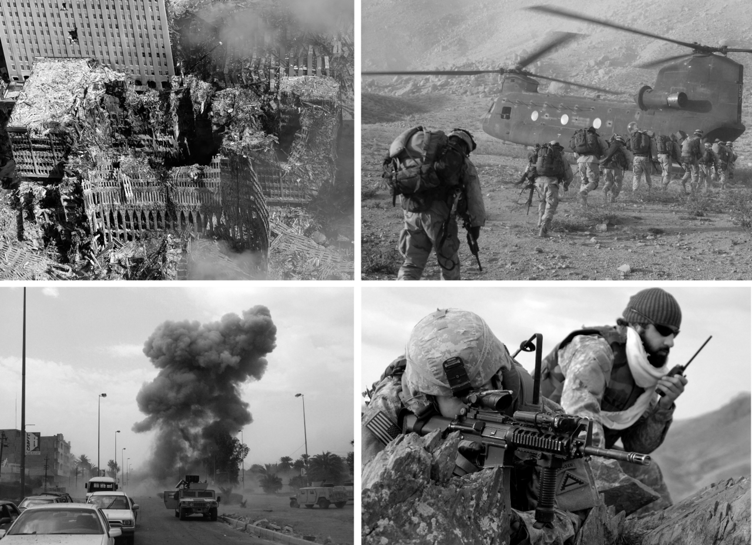
The Global War on Terror
Dr Jonathan Leader Maynard
jonathan.leader_maynard@kcl.ac.uk
www.jleadermaynard.com @jleadermaynard

Slide 2
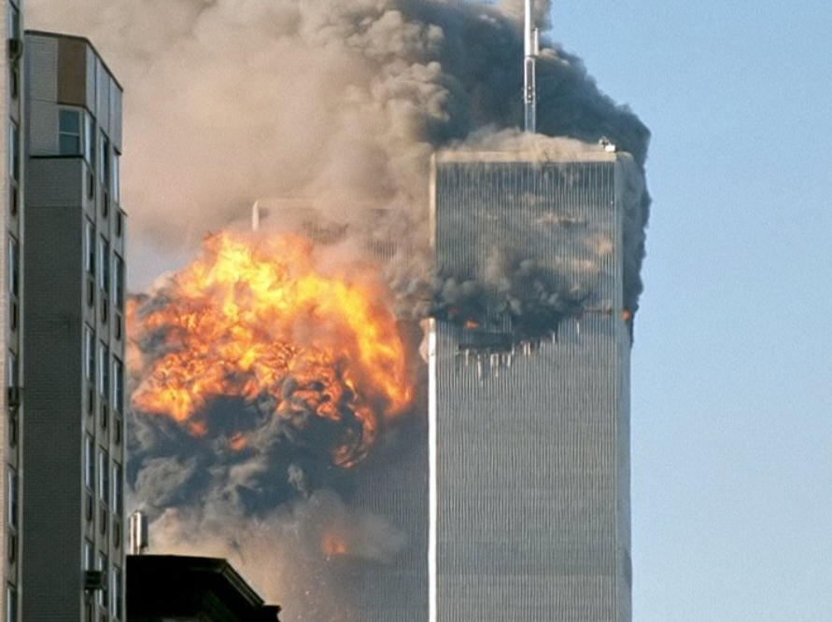

Slide 3
What is/was the Global War on Terror?

Slide 4
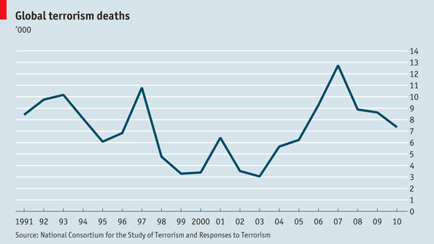

Slide 5
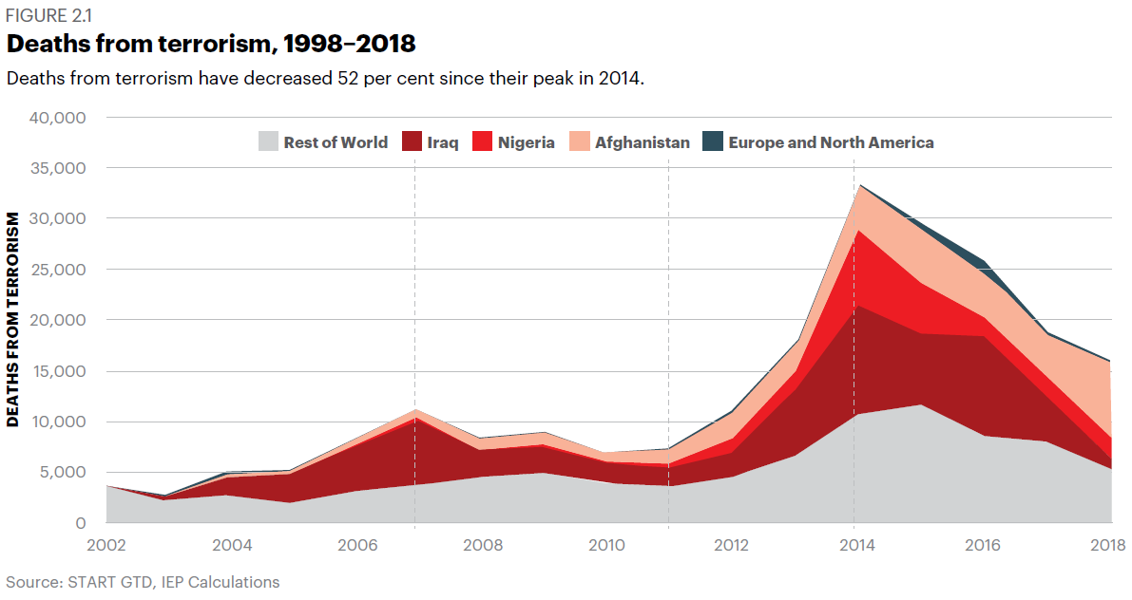

Slide 6
See also: John Mueller, ‘Is there still a terrorist threat?’ (2006)
Notes:
Deaths per Year count is 2012-16 for terrorism , 2014-2015 for Drug Use, and GTI’s figure on average global homicides.

Slide 7
“Because of Saddam and the Baath Party, America punished a whole population. Thus its bombs and its embargo killed millions of Iraqi Muslims… God said to assault whoever assaults you, in a like manner…. In killing Americans who are ordinarily off limits, Muslims should not exceed four million non-combatants, or render more than ten million of them homeless. We should avoid this, to make sure the penalty is no more than reciprocal.”
- Ramzi bin al-Shibh, ‘key facilitator for the September 11 attacks’

Slide 8
“For over seven years the United States has been occupying the lands of Islam in the holiest of places, the Arabian Peninsula, plundering its riches, dictating to its rulers, humiliating its people, terrorizing its neighbours…
Despite the great devastation inflicted on the Iraqi people by the crusader-Zionist alliance, and despite the huge number of those killed, which has exceeded 1 million… the Americans are once again trying to repeat the horrific massacres… to annihilate what is left of this people…
All these crimes and sins committed by the Americans are a clear declaration of war on Allah, his messenger, and Muslims… [therefore] The ruling to kill the Americans and their allies – civilians and military – is an individual duty for every Muslim who can do it… in order to liberate the al-Aqsa Mosque and the holy mosque [Mecca] from their grip, and in order for their armies to move out of all the lands of Islam, defeated and unable to threaten any Muslim.
- Al-Qaeda’s ‘Fatwa Against the West’, February 1998

Slide 9
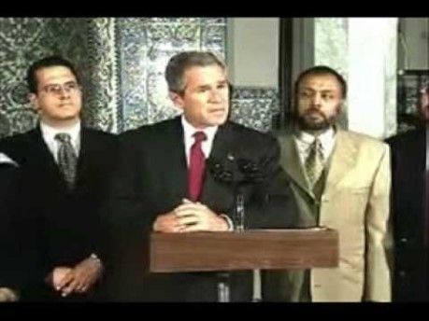
“These acts of violence against innocents violate the fundamental tenets of the Islamic faith… The face of terror is not the true faith of Islam. That's not what Islam is all about. Islam is peace…
America counts millions of Muslims amongst our citizens, and Muslims make an incredibly valuable contribution to our country. Muslims are doctors, lawyers, law professors, members of the military, entrepreneurs, shopkeepers, moms and dads. And they need to be treated with respect. In our anger and emotion, our fellow Americans must treat each other with respect.”
- President George W. Bush, 17 September 2001

Slide 10
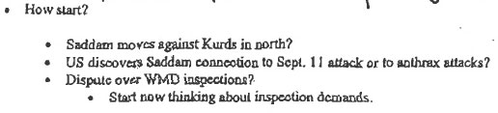
Elements of the War on Terror
Rewriting of the Norms of Security and War:
Bush administration declares Geneva Conventions do not apply to terrorists (September 2001), individuals kept at Guantanamo Bay are detained without trial or subject to military trials.
USA PATRIOT ACT (26 October 2001) authorizes indefinite detentions and enhances state secret surveillance powers.
US government employs illegal extraordinary rendition and torture at black sites as part of its counterterrorism intelligence gathering.
The Bush Doctrine: Unilateralism, Preventive War and Regime Change
Use of Military Action
War in Afghanistan (7 October 2001 to present)
Iraq War (20 March 2003 to 18 December 2011)
US Interventions in North West Pakistan (2004 to present)
International campaigns against ISIL (13 June 2014 to present)
Ideological/Cultural ‘Battle for Hearts and Minds’
Casting of the war on terror – against terrorist organisations and supporting states pursuing Weapons of Mass Destruction – as the central theme of and threat to US policy in early 21st Century.
Dichotomisation of world politics between the free and civilised world – associated with democracy, human rights, women’s rights – and axis of evil comprised of Iraq, Iran, North Korea, and terrorist actors.
Definition of the scope of the War on Terror as Global.

Slide 11
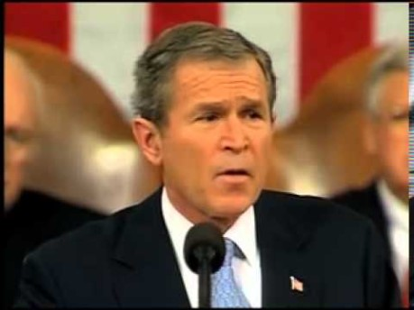

Slide 12
Explaining the War on Terror

Slide 13
The Clash of Civilizations (Huntington)
A mis-strategized attempt at a Global Compact Against Terrorism? (Boyle)
Neoconservatism and the Israeli Lobby? (Lind; Mearsheimer & Walt)
Imperial Ambitions? (Ikenberry, Denike)
Racism and Islamophobia? (Khalid, Kundnani)
Private Profit and Oil? (Denike, Klare)
Affective Waves? (Hall & Ross)

Slide 14
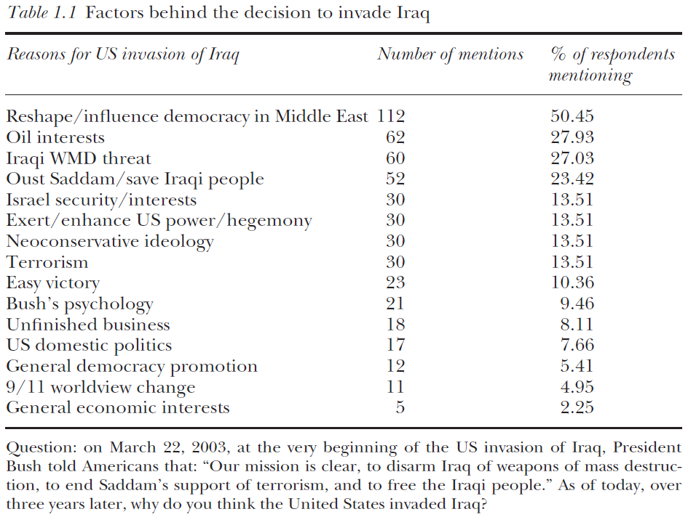
Notes:
All from Cramer & Thrall, ‘Why did the United States invade Iraq?’

Slide 15
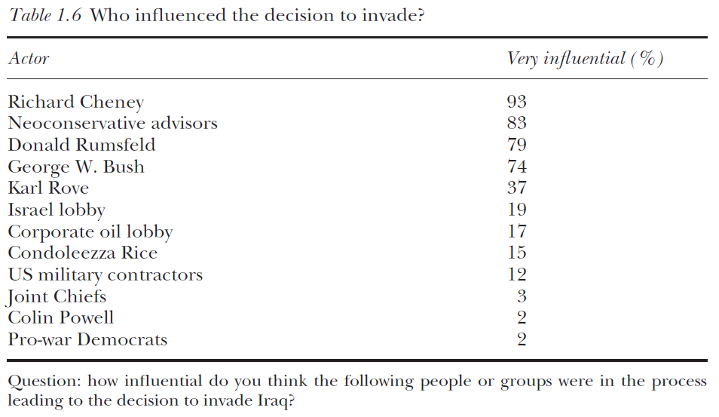

Slide 16
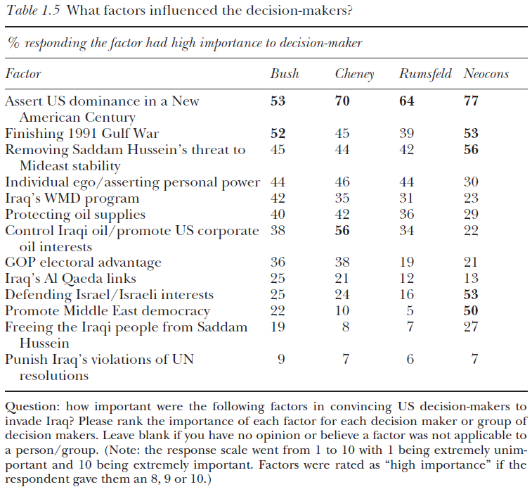

Slide 17
“The stories that are told that justify intervention – about the barbarism of other cultures and the need for the international community to “take responsibility” to intervene – are part and parcel of the creation of international political order that, through these stories, utilizes longstanding colonial distinctions between “humanity” and its “others” and entrenches the difference between them. This distinction between a civilized us and a barbaric enemy other, not only reenacts and reinforces racist colonial stereotypes through its pretence of benevolent protectionism, but… works to erase the violence of interventions…
Masquerading the profit-driven ‘war on terror’ as a chivalrous, just and necessary response to evil also works to conceal the direct investment of its architects…in the industry of war, and to case the lucrative contracts of building schools, medical facilities, and water supplies as a matter of delivering the cherished rights to those who were previously denied them.”
- Margaret Denike, ‘The Human Rights of Others’

